Slide 1
Lab 5 Inheritance
DEE 1319
Department of Electronics Engineering
National Chiao Tung University

Slide 2
Outline
Inheritance basics
Derived classes
Protected: qualifier
Redefining member functions
Programming with Inheritance
Assignment operators and copy constructors
Destructors in derived classes
Exercise

Slide 3
Derived Classes (1/3)
What’s Inheritance
Purpose: Object-Oriented Programming
Provides abstraction dimension:
Defines general form of class, then specialized versions inherit properties of general class
Add new/modify base’s functionality for it’s appropriate use
general form
specialized version
Employee
Part-timer
Manager

Slide 4
Derived Classes (2/3)
Base class
"General" class from which others derive
Derived class
New class
Automatically has base class’s:
Member variables
Member functions
Can then add additional member functions and variables

Slide 5
Derived Classes (3/3)
Example:
Base Class
Each Employee has name and will be paid
An Employee may be…
SalariedEmployee
HourlyEmployee
Manager
Each is "subset" of employees

Slide 6
Base Class: Employee
Class definition is just like what we done before
Example: class Employee { string first_name, family_name; char middle_initial; Date hiring_date; short department; public: string full_name(); // … };

Slide 7
Derived Classes: Manager
Derived class interface only lists new or "to be redefined" members
Example: class Manager: public Employee { // public inheritance Employee* group[100]; // people managed short level; // … };
All the variables (first_name, department, …) which belong to Employee, the Manager also has them

Slide 8
Pointer’s Conversion
Because a Manager is also an Employee, we can make the Employee‘s pointer point to the Manager
Example: (upcasting) Manager m; Employee *pe= &m; // “OK,” public inheritance
But the inverse conversion (downcasting) will cause a damage (An Employee is not a Manager certainly)

Slide 9
Access Controls
The same access control rules still apply in a inheritance relationship
Generally, data member won’t be public (packaging)
Use interface to access these data members
Example: void Manager::print() const { cout<< “Name is ” << full_name() << endl; // OK, if full_name() is a public member (interface) } void Manager::print() const { cout<< “Name is ” << family_name<< endl; // ERROR, if family_name is a private member }
Belongs to Employee::
Belongs to Employee::

Slide 10
Constructor
Constructor (Ctor) of derived class is responsible to call ctors for its base classes (and its own non-staticclass data members)
Example: Manager::Manager(string& name, short dep, int lvl) : Employee(name, dep), level(lvl) { // … } // initialize base and non-static data members
Initialize base and non-static data members using their corresponding ctors
Default ctor for base/derived should be well defined
Belongs to Manager::
Belongs to Employee::

Slide 11
Execution Order of Constructor
struct A { A() { cout<< “ctorA” << endl; } ~A() { cout<< “dtorA” << endl; } }; struct B { B() { cout<< “ctorB” << endl; } ~B() { cout<< “dtorB” << endl; } }; struct C : public B { A a; C():B(), a() { cout<< “ctorC” << endl; } ~C() { cout<< “dtorC” << endl; } }; int main() { C c; return 0; }
B
C
A
Output:
========
ctor B
ctor A
ctor C
dtor C
dtor A
dtor B

Slide 12
Copy Ctor & Assignment Operator
Copy ctors and copy assignment operators are never inherited (should be rewrited)
Example: struct C : public B { A a; int d; int* pi; C(int n1=0, int n2=0, int n3 = 0) : B(n1), a(n2), d(n3) { pi = new int[10]; for(int i=0; i<10; ++i) pi[i] = i; } C(const C& c) : B(c), a(c.a), d(c.d) { // c is also of type B pi = new int[10]; for(int i=0; i<10; ++i) pi[i] = c.pi[i]; } C& operator=(const C& c) { B::operator=(c); a = c.a; d = c.d; int* tmp= new int[10]; for(int i=0; i< 10; ++i) tmp[i] = c.pi[i]; delete[] pi; pi = tmp; return *this; } ~C() { delete[] pi; } };
Call B’s constructor
Rewrite
copy ctor
Rewrite
Assignment operater

Slide 13
Protected Members
Protected members (data and functions)
Its name can be used by member functions and friends of the class only in which it is declared, and by member functions and friends of classes derived from this class
void D::d_func() { // D is derived from B
b_priv= 1; // error
b_prot(); // ok
b_pub(); // ok // … }
void func(B& b) { // a global function
b.b_priv= 1; // error
b.b_prot(); // error
b.b_pub(); // ok
// … }
Class B {
int b_priv;
protected:
void b_prot();
public:
void b_pub(); };
class D : public B {
public:
void d_func(); };

Slide 14
Different Kind of Inheritance
Like a member, a base class can be declared private, protected, or public
class X : public B { / * … */ }; // public inheritance
Public inheritance models is “is-a” relationship
class Y : protected B { / * … */ }; // protected inheritance
class Z : private B { /* … */ }; // private inheritance
both model are “is-implemented-in-terms-of” relationship
Member in base class | Type of Inheritance
 | public | protected | private
public | public | protected | private
protected | protected | protected | private
private | no access | no access | no access

Slide 15
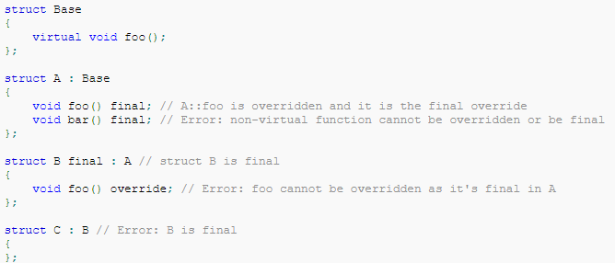
final specifier (since c++11)
Specifies that a virtual function(will be introduced in future) cannot be overridden in a derived class or that a class cannot be inherited from.

Slide 16
Is-a vs. Has-a
“Is-a” relationship is modeled by public inheritance
class Manager : public Employee { /* … */ };
It says a Manager is an Empoyee
“Has-a” relationship is modeled through composition
Also called layering
class Employee { string first_name, family_name; // … };
It says every Employee has a first_nameand a family_name

Slide 17
Lab5 Exercise
Given an employee list of a company
This list may contain 4 kinds of employee
Part-timer (P), Manager (M), Employee(E) ,and Chairman (C)
File format
Total number of employee
Name: [worker’s name]
Title: [worker’s title]
Years of service for each employee (a float number)
You also need dynamic array or vector to store graphs
But, not “array of object”
Dynamic array: (base_employee must have default constructor)
base_employee* object=new base_employee[n]

Slide 18

Testcase Example
Example:

Slide 19
Problem Formulation
Problem formulation
Given: a file contains employee list of a company
Purposes: sort these employees with their salary
Constraints:
Build up 4 derived classes (parttimer, employee, manager, and chairman) by yourself, and the base class base_employee is given
Parttimer and manager is derived from base_employee, and chairman is derived from manager
Salary formula: (base salary) + (additional payment)
The base class CANNOT be modified, please inherit it properly
A reference is provided to help you for developing your prog.
Output: print out worker’s salary in descending order

Slide 20
Salary Formula
For each kind of employee, their base salary is:
Base salary of employee (BSE): 22000/month
Parttimer: BSE
Employee: BSE + 3,000*(year)
Manager: BSE + 24,000 + 5,000*(year)
Chairman:
salary of Manager + 40,000 + 5,000*(year)
The salary of each employee can be calculated in its constructor or member function

Slide 21
Some Useful Hints
When you inherit base a class, remember..
Use functions (interface) the base class provided
E.g., get_year(), get_salary(), …
Shouldn't access private member directly
Basic concept of OOP
Constructor may not be inherited
Essential data members of an object should be built up via its constructor
Pointer of basic class also can point to the derived class
If a global function need to access private member
It should be declared as a friend

Slide 22
Output Format
Output format
Total salary payment of this company
Worker’s information of this company
Manager: [#M] Employee: [#P]
A chairman is also a manager
All employees’ salary with descending order
[worker’s name] [title] [year of service] [salary]

Slide 23
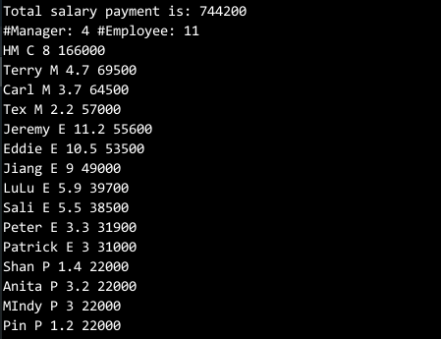
Execution Result

Slide 24
Homework
Congratulation No Homework

